Slide 1
EF-EP-002
EPIC: App download: QR Code
Describes how to host the App and QR code generation

Slide 2
EF-EP-002: App download: QR Code
Story ID: ES-S001-JZ:
As a user, I want to scan a QR code to download the app, so that I can process an application.
Story ID: ES-S002-JZ:
As a user, I want to scan a QR code in app, so that I can get information prefilled.
Story ID: ES-S000-JZ:
As an F&I, I want to generate the QR code for user, so that they can have a application with prefilled information.

Slide 3
Story ID: ES-S001-JZ:
Business
As a user, I want to scan a QR code to download the app, so that I can process an application
Assumptions:
User in dealer site.
User would like to apply from their own device.
Pre-Conditions:
There must be a site to download app
Acceptance Criteria:
The site should apply to BMW standard
If QR code is posted, poster must align with BMW standard
IT
Security

Slide 4
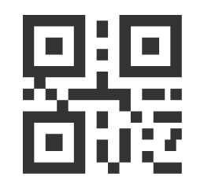

Story ID: ES-S000
Mockups:
Open one app with scan function
Scan QR code
BMW Easy Finance Download Page
Please Click below links to download Application
Install app?
iOS
Install
Cancel
Android

Slide 5
Story ID: ES-S002-JZ:
Business
As a user, I want to scan a QR code in app, so that I can get information prefilled
Assumptions:
User in dealer site.
User would like to apply from their own device.
User has selected a product/SF product, and doesn’t want to input again
Pre-Conditions:
User has downloaded the app
The app can scan QR code and parse the information from QR
Acceptance Criteria:
The QR code should be parsed, and prefill the product information (vehicle info to map into web calculator) in eApp
The page from QR code should not be displayed by other browsers
IT
Security

Slide 6
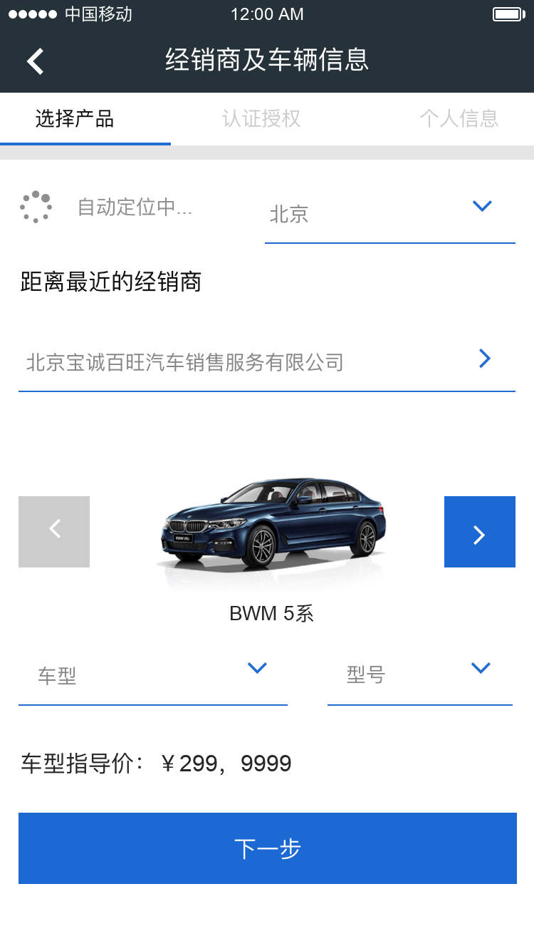
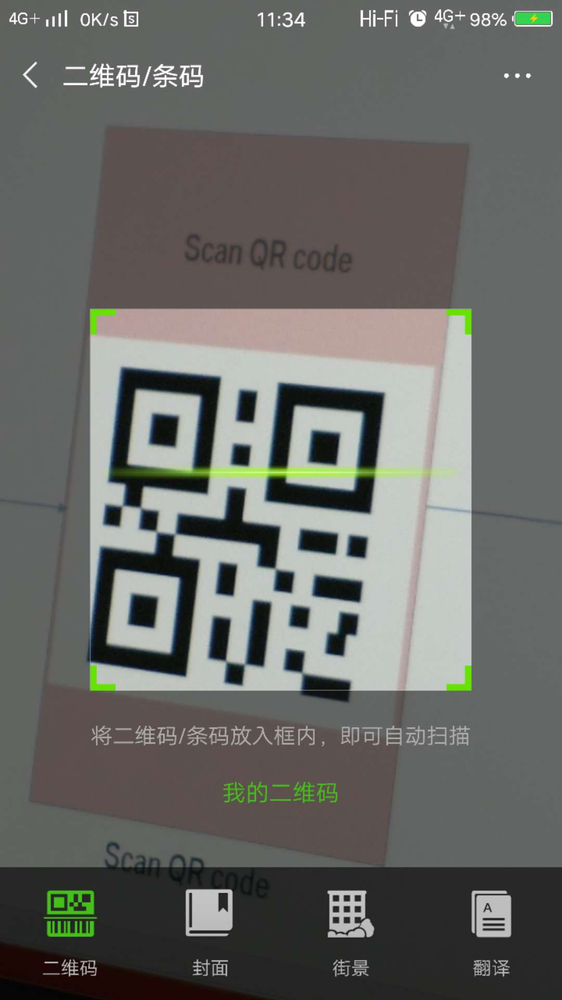

Story ID: ES-S000
Wireframes & Mockups:
北京
北京华德宝汽车销售服务有限公司
525i
M运动套装
Click QR code scanner
Scan QR code
Fill the vehicle information from DFE

Slide 7
Story ID: ES-S003-JZ:
Business
As an F&I, I want to generate the QR code for user, so that they can have a application with prefilled information
Assumptions:
User in dealer site.
User would like to apply from their own device.
Pre-Conditions:
User has downloaded the app
The app can scan QR code and parse the information from QR
Acceptance Criteria:
The QR should contain all information from DFE
The QR code should be parsed, and prefill the information in eApp
The page from QR code should not be displayed by other browsers
IT
Security

Slide 8
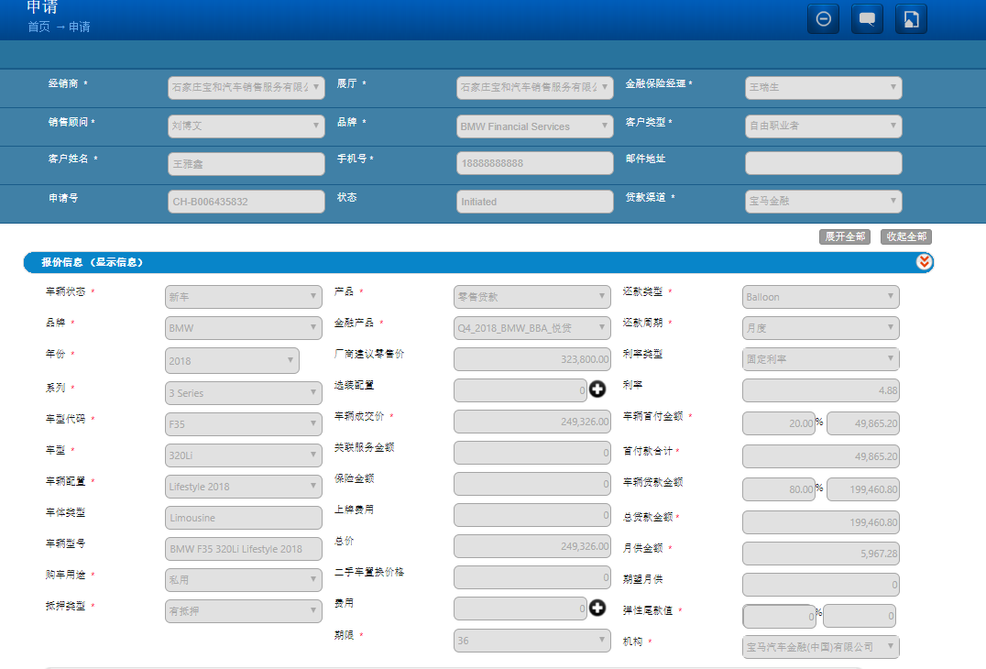
Story ID: ES-S000
Wireframes & Mockups:
Please let customer scan QR code with eApp
Close
Comfirm
Generate QR code
F&I input information in DFE
Clicks “Generate QR”
QR code will generate accordingly and pop up

